Slide 1
UNIT 5

Slide 2
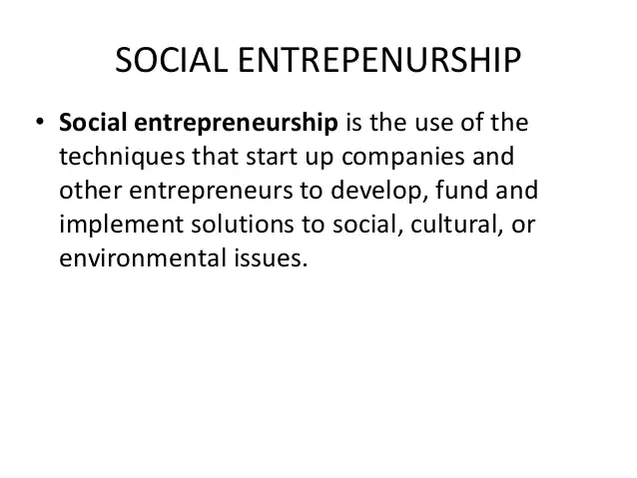
Social Entrepreneureship

Slide 3
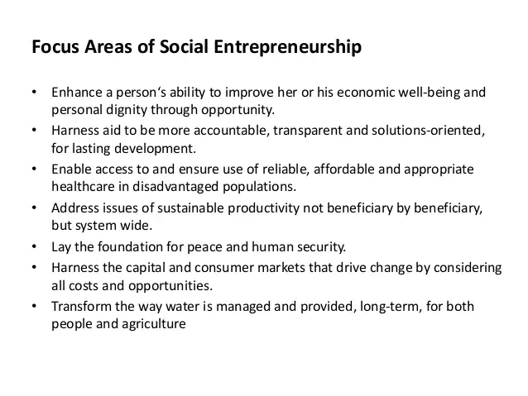
Social Entrepreneurship

Slide 4
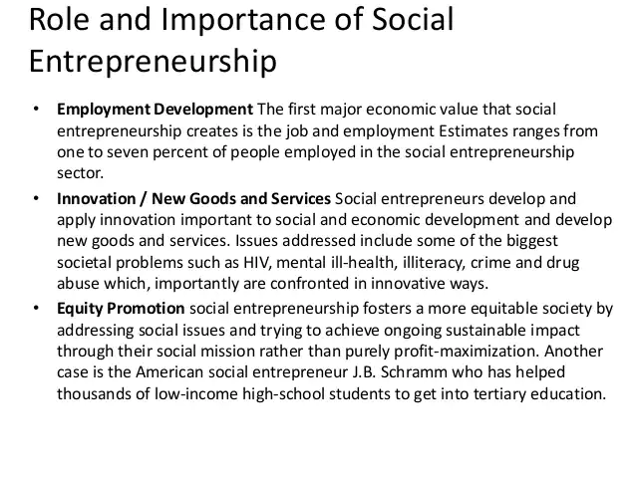
Social Entrepreneurship

Slide 5
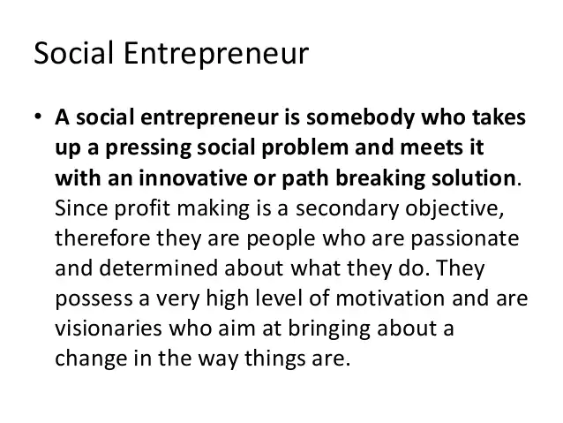
Social Entrepreneurship

Slide 6
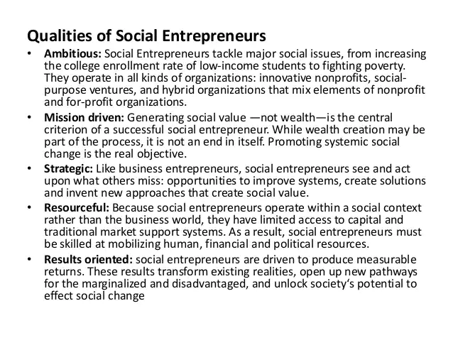
Social Entrepreneurship

Slide 7
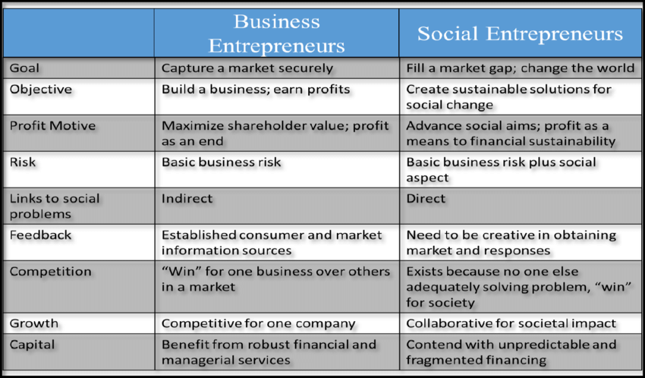
Social Entrepreneurship

Slide 8
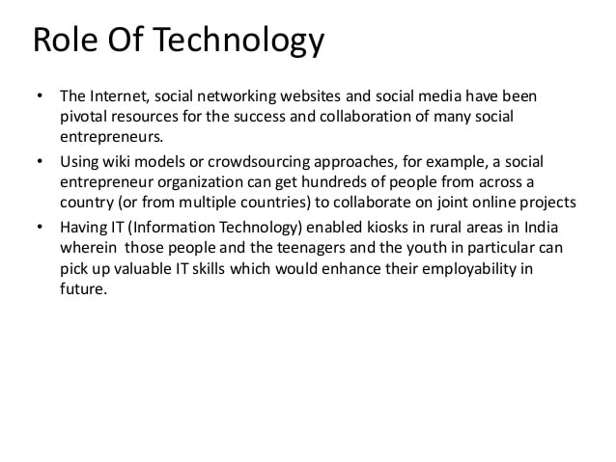
Social Entrepreneurship

Slide 9
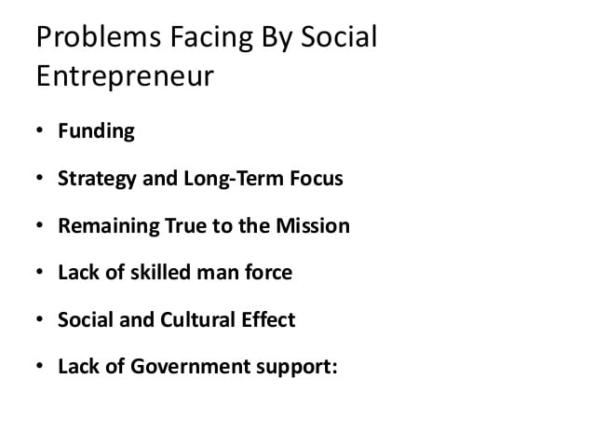
Social Entrepreneurship

Slide 10
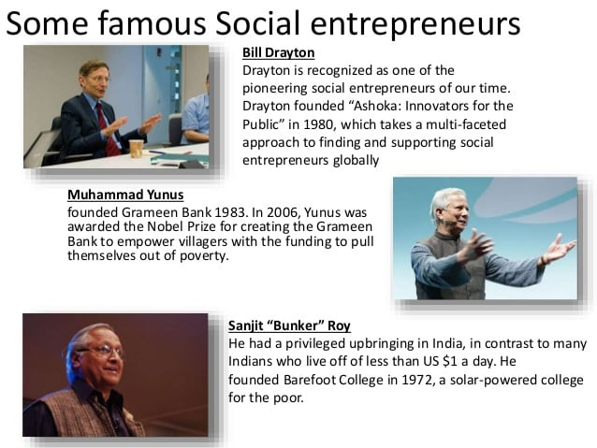
Social Entrepreneurship

Slide 11
Opportunités for Social Entrepreneurs In India
Here we are listing some untapped opportunities for the budding entrepreneurs:
1. Waste Management:
In Indian context, this is a journey or race with no 'finish line'. On the ground, various solutions, best practices and business models have emerged. In some areas, we see some cases of dramatic turnarounds. In many other cases the situation is only worsening owing to delays and at best inaction. Progress is visible in the space of solid waste management. Sewage or liquid waste management is still largely left to traditional approaches and conventional systems that either don't work or are fraught with gaps in implementation.
The current solutions are infrastructure based, require large investments and are always on a catch up mode. But you as an entrepreneur you can tap this unexploited space with you innovate idea and can churn out money from here

Slide 12
Opportunités for Social Entrepreneurs In India
2. Deep Cleaning Services
For aspiring entrepreneurs this a great sector to tap. Cleaning industry is still untapped and it needs young blood to step in and change the face of the sector by using their innovative skills and techniques.
3. Green Infrastructure:
Green Infrastructure is vital in providing and connecting life support systems for urban environments. It includes parks and reserves, gardens, waterways and wetlands, streets and transport corridors, pathways and greenways, squares and plazas, roof gardens and living walls, just to name a few

Slide 13
Opportunités for Social Entrepreneurs In India
4. Water Management:
Water is one of the most important element of life. But the scarcity of drinking water, is appalling. In today’s time, access to clean water is the biggest achievement for any family living in remote areas of the country. You, being an entrepreneur, can look into this matter and figure out the best way to solve this problem with the help of your entrepreneurial skills.

Slide 14
9 Social Enterprise Business Models
A social business model is therefore a structure, design or framework that a social business follows in order to bring about a positive change while maintaining healthy financial returns.
The entrepreneur support model that sells business support services directly to the entrepreneurs in its target population
The market intermediary model that helps their clients by marketing or selling their clients’ products or services for them
The employment model, in which a social enterprise provides their clients with job opportunities and job training
The fee-for-service -model where a social enterprise charges the customer directly for the socially beneficial services it provides
The low-income client model where a social enterprise generally offers social services directly (as in the fee-for-service model) while focusing on low-income clients
The cooperative model, a fee-based membership organization that provides member services to a group that shares a common need or goal

Slide 15
9 Social Enterprise Business Models
The market linkage model that focus on building relationships and otherwise connecting their clients with markets for their clients’ products and services
The service subsidization model that funds social programs by selling products or services in the marketplace.
The organization support model also sells products or services to fund social programs (as the service subsidization model). However, the social programs they fund are part of a separate, parent organization

Slide 16
The role of Marketing in Social Entrepreneurship
Marketing strategy is the key element in building a sustainable business venture. It starts with clarifying the vision, mission and values of the social enterprise, analyzing the potential users and competitors and elaborating the market determinants such as product, price, placement and promotion. Managing effective distribution systems, promotion and communication are important factors in achieving the desired social impact.
Marketing for social entrepreneurship is a social and managerial process in which individuals and groups receive what they want and need through the exchange of products and values. The task of marketing is to identify and define specific markets for specific products.

Slide 17
Marketing research and analysis
The first step in successfully positioning the new business venture, is to conduct a thorough marketing research, analyzing who the existing and potential users of the products and services will be, what is the market size and who are the competitors.
The market should be analyzed in terms of demographics, social-economical and geographical distribution and size. Useful question that should be asked on this stage are:
Who are you targeting?
What are the main characteristics of the target group?
How many people you want to reach?
Where are those people?

